Slide 1
Big Mountain Resort Data Science Response Team
Presented By:
Brianna Abdalla

Slide 2
Problem Identification
Big Mountain is a top resort that attracts 350K visitors annually.
The new chair lift will increase operation costs by $1.54 million this season.
Current pricing strategy is to charge a premium above the average price.
But what if this was limiting revenue and growth opportunities?
Imagine defining a ticket price based on the value we are actually bringing to our customers!

Slide 3

Problem Statement
How can Big Mountain Resort maintain a profit margin of at least 9.2% while recovering from increased operation costs of $1.54 million and identify key resort features for an improved investment strategy for the current season and next year?

Slide 4
Recommendations & Key Findings
We recommend increasing ticket price to $85.00
Top features that drive predicted ticket price include:
fastQuads
Runs
Snow Making_ac
vertical_drop
Top ideas for resort improvements:
Remove 5 runs with the least use.
Add a run that increases vertical drop by 150ft with an added chairlift.

Slide 5
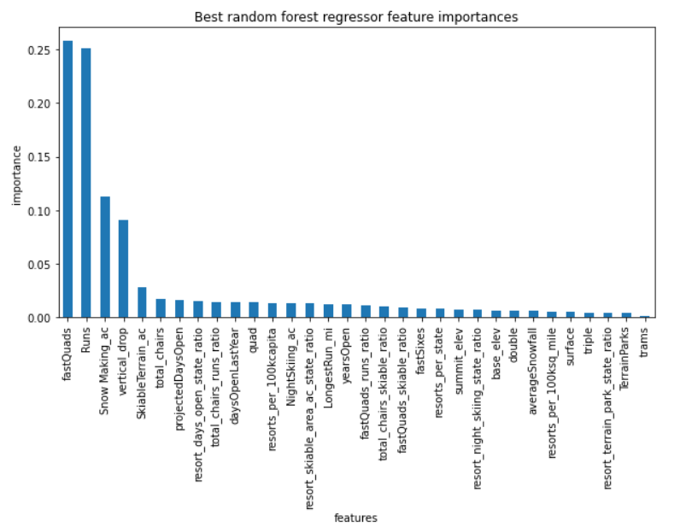
Modeling Results & Analysis

Slide 6
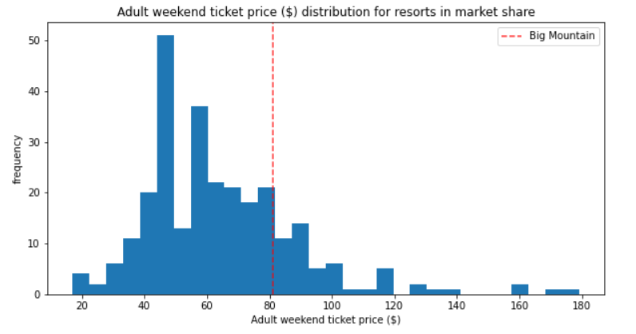
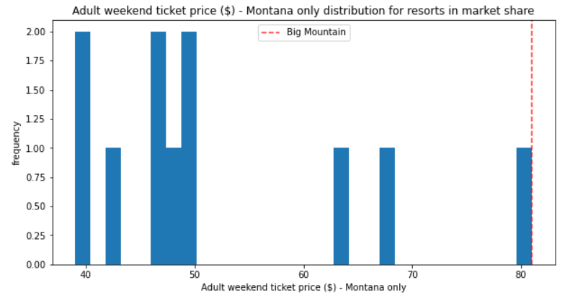
Modeling Results & Analysis
Model predicted price: $95.87
Expected mean absolute error: $10.39

Slide 7
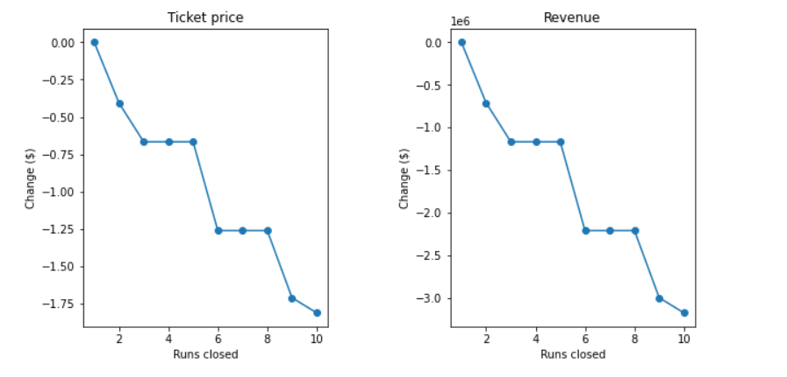
Modeling Results & Analysis
How does closing slow runs change predicted price?

Slide 8
Summary & Conclusion
The model is a useful tool that can bring insight into future planning and price predictions.
A ticket price of $85.00 is supported.
Improved model suggestions include:
Visitor count
Historical data
Cost information

